Slide 1
Regional Innovation System (RIS)
Some of this lecture is based on:
Asheim, Rjorn, and Meric G. Gertler. 2012. The Geography of Innovation: Regional Innovation Systems. In The Oxford Handbook of Innovation edited by Jan Fagerberg, David C. Mowery, and Richard R. Nelson. Oxford University Press.

Slide 2
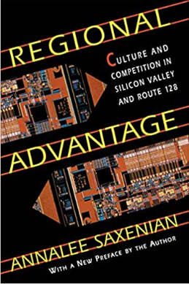
Regional Advantage: Culture and Competition in Silicon Valley and Route 128 (AnnaLee Saxenian,1994)
Compared two premier industrial clusters drawing on more than 100 interviews
Commonality?
Both emerging from Cold War technologies propelling new high-tech firms and industries
Both developing complexes of technology, entrepreneurship, and venture capital in the 70s and then facing severe economic downturns in the 80s
Difference?
Silicon Valley recapturing much of tech and economic dynamism, while Route 128 continuing to decline

Slide 3
Regional Advantage: Silicon Valley vs. Route 128
Silicon Valley
- Open networks of communication and exchange Job mobility
- Mingling at local business/social gatherings
- “Laid back” about sharing of information/skills
- Venture capital
Route 128
- Autarkic, vertically integrated companies
- Stigma for job changes
- Secretive, self-contained
- Protectionist of IPR
- Traditional financing

Slide 4
Book Reviews
What state would not like to have the "next" Silicon Valley? But while Saxenian has some pertinent advice about policy (including the role of universities), it is not at all obvious how to reproduce the patterns that have made Silicon Valley successful. – Paul Starr 1995

Slide 5
Book Reviews
Despite its rich institutional analysis, Regional Advantage tells only one side of the story. – Richard Florida (1994)
Neglects the role of highly competitive local markets
Overlooks the high degree of fragmentation, chronic entrepreneurism, and extreme litigiousness that equally defined the Silicon Valley style of high tech.
Joint Venture: Silicon Valley – first attempt at regional coordination to transform the “valley of entrepreneurs into an entrepreneurial valley”
Romantic account of American high tech, missing the human toll taken by a pressure-cooker environment (round-the-clock work hours, low wages and conditions of high-tech factory workers, etc.)

Slide 6
Book Review Special (1995) from Economic Geography
Eschewing national-level determinants (as Saxenian herself is critical of NIS for its failure to accord importance to regional institutions), yet regional development trajectories weren’t immune from national regulatory forces – Meric Gertler

Slide 7
Book Review Special (1995) from Economic Geography
Silicon Valley is not a paradise. It is a halfway house between what would be a fully successful regional production culture and standard US languages, beliefs and practices about production. – Michael Storper

Slide 8
Book Review Special (1995) from Economic Geography
Patricia Limerick (1987), The Legacy of Conquest → continuities between the gold-rush era exploration and the new pioneers of the electronic age over six generations reproducing Reproduction of the East as packed with stultified, arrogant, authoritarian elitists, corporations, and government agencies – Philip Scranton

Slide 9

The Rise of the Creative Class (Richard Florida, 2002)
“Creative Class Index” measuring the size of knowledge workers (scientists, engineers, professors, managers, designers, entrepreneurs, lawyers, programmers, poets, musicians, think-tank employees, …)
“Bohemian Index” counting the # of artists, writers and performers
Explores factors that shape “quality of place”

Slide 10
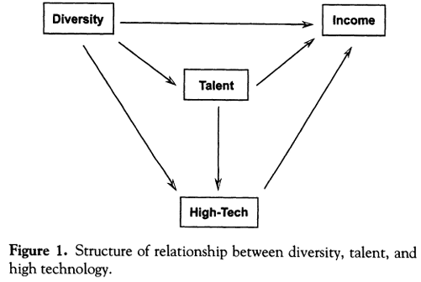
Economic Geography of Talent (Florida 2002)
Two interrelated mechanisms attracting talent
Quality of life (lifestyle amenities)
Economic opportunities
(Jobs, wages…)
Amenities being a key component of modern cities (“Entertainment Machine”, Lloyd and Clark 2001)

Slide 11
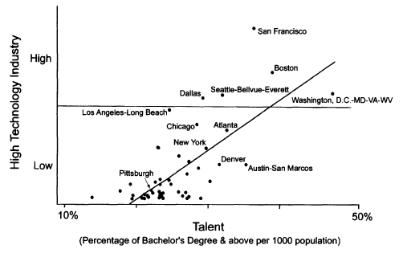
Economic Geography of Talent
0.42

Slide 12
Economic Geography of Talent
Amenity Measures: traditional indicators of climate, cultural and recreational amenities
Coolness Index: % of population ages 22-29, nightlife (# of bars, nightclubs, etc. per capita), culture (# of art galleries and museums per capita)
Diversity Index: “gay index” implying lower barriers to entry for human capital
Given that the gay population has long faced discrimination and ostracism.

Slide 13
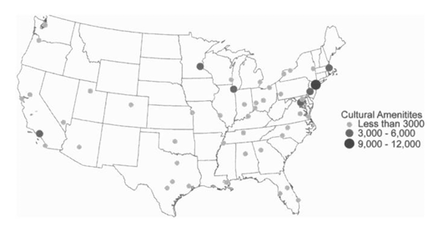
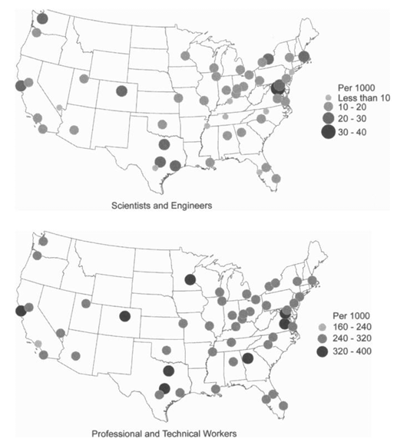
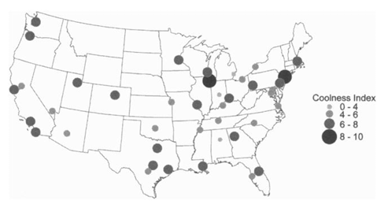

Economic Geography of Talent
vs

Slide 14
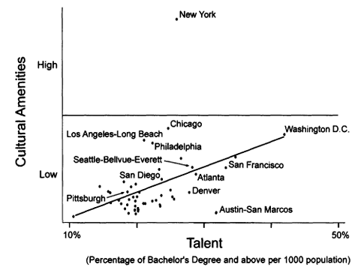
Talent vs. Cultural Amenities
0.4298

Slide 15
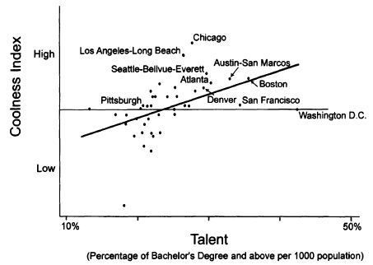
Talent vs. Coolness
0.469

Slide 16
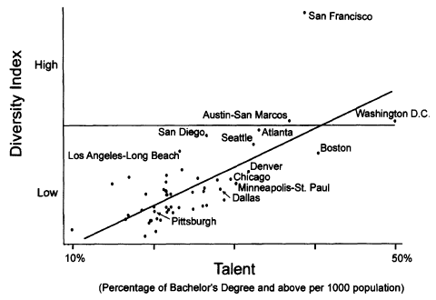
Talent vs. Diversity
0.718

Slide 17
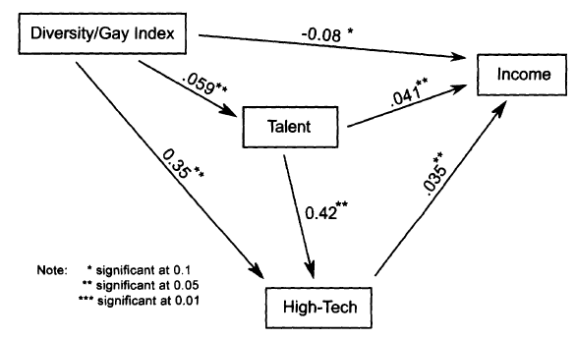
Implications
Talent is not just an endowment or stock that is in place in a given region; certain regional conditions are required to attract talent.

Slide 18
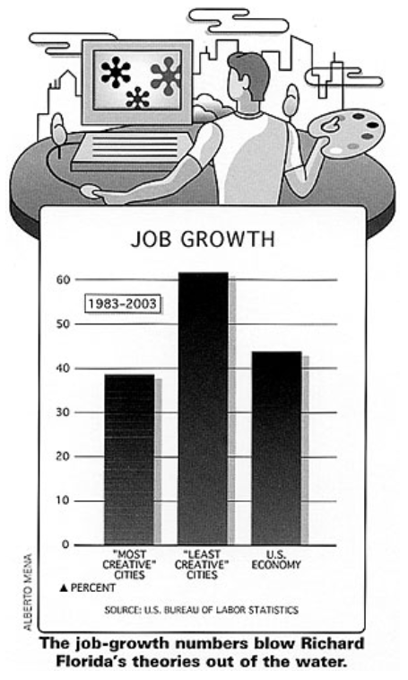
Criticisms
National Commission on Entrepreneurship study, “Mapping America’s Entrepreneurial Landscape” (2001)
High growth centers measured by the percentage of companies in a local economy growing by 15% per year for 5 consecutive years (in the mid-1990s)
Finding most fast-growing entrepreneurial companies were not in high-tech industries, rather widely distributed across all industries.
S. Malanga (2004), “The Curse of the Creative Class,” City Journal

Slide 19
Geography of Innovation
Geography is fundamental, not incidental, to the innovation process.
Why does “location” matter for innovation activities?
What is the relationship between RIS and NIS?
What is the relationship between local and global knowledge flows?
How has globalization weakened or altered the influence of proximity on the geography of innovation?

Slide 20
Geography of Innovation
Innovation at the subnational scale
Spatial proximity
Tacit knowledge
Innovation is increasingly dependent on interactions and knowledge flows between economic entities (customers, suppliers, competitors), research organizations (universities, private/public research institutions), and public agencies (development agencies, tech transfer centers, etc.).

Slide 21
Tacit Knowledge Doesn’t Travel Far
Tacit knowledge
Implicit knowledge
Know-how (as opposed to know-what, know-why)
Wisdom, experience, insight, intuition…
Tacit knowledge is difficult to exchange over long distances.
Knowledge imbued with meanings arising from social and institutional context → spatially sticky knowledge

Slide 22

Tacit Knowledge
“All knowledge is personal.”
“We know more than we can tell.”
Personal Knowledge. The two words may seem to contradict each other: for true knowledge is deemed impersonal, universally established, objective. But the seeming contradiction is resolved by modifying the conception of knowing. – Michael Polanyi

Slide 23
Tacit Knowledge & Learning by Interacting
Learning by interacting as a process of joint innovation and knowledge production
Users providing tacit and codifiable knowledge to producers for innovative solutions to their problems
Producers sharing tacit and other proprietary knowledge with their customers
Producing new knowledge that could not have been provided by either party working alone
Essentially collective learning process, which are highly time- and space-specific.
Ability to interpret “local codes”

Slide 24
Localized Capabilities
Localized capabilities and intangible assets that only local firms can appropriate
Difficult to emulate by would-be imitators in other regions
Preserving initial advantage of “first mover” regions
It’s the region’s distinct in institutional endowment that embeds knowledge and allows for knowledge creation which – through interaction with available physical and human resources – constitutes its capabilities … of the firms in the region. – Maskell & Malmberg (1999)

Slide 25
Knowledge Base
Synthetic Knowledge Base
Analytical Knowledge Base
Prevails in industrial setting where innovation takes place mostly through novel combination of existing knowledge
Application-oriented, incremental product/process development, experimentation, practical work, inductive testing
e.g., specialized industrial machinery, plant engineering, shipbuilding
Dominates economic activities where scientific knowledge is highly important
Both in-house R&D and university-industry links crucial for basic/applied research, more codified knowledge, rational processes, radical innovations
e.g., biotechnology, information technology

Slide 26
Puzzle
Industries based on analytical knowledge are no less spatially concentrated than those based on synthetic knowledge base. They may even exhibit a higher degree of geographical concentration! (Cortright & Mayer 2002).

Slide 27
1. Knowledge of Failures
Despite the importance of codified knowledge in analytically based industries, the circulation of new knowledge remains highly localized.
Because knowledge spillovers occur first, fastest and most readily within established local networks
Knowledge of failures in scientific experiments rarely published
Could save considerable time and expense if this knowledge of unproductive lines of inquiry is shared.

Slide 28
2. Human Capital
Central importance of highly educated (and footloose) workers
Places offering attractive employment opportunities
Local labor market rich and deep enough to promise continuous employment opportunities
Critical mass of people working in similar occupations
All these leading to increasing returns dynamics that generates a virtuous cycle of growth

Slide 29
3. Quality of Life
High quality of life attracting skilled/creative workers
Social diversity
Tolerance
Most livable city?
Vienna (EIU’s Global Livability Ranking 2022)
Copenhagen (Monocle’s Quality of Life Survey 2021)
London (Global Finance’s World’s Best Cities to Live, 2022)
Zurich (Deutsche Bank Livability Survey, 2019)
Adelaide (Numbeo’s Quality of Life Ranking, 2021)

Slide 30
RIS
Concept emerged with the success of regional clusters and industrial districts in the post-Fordist era
Piore & Sable (1984), The Second Industrial Divide, Basic Books
Cooke (1992), Regional Innovation Systems: Competitive Regulation in the New Europe, Geoforum 23
Asheim (1996), Industrial districts as ‘Learning Regions,’ Economic Planning Studies 4(4)

Slide 31
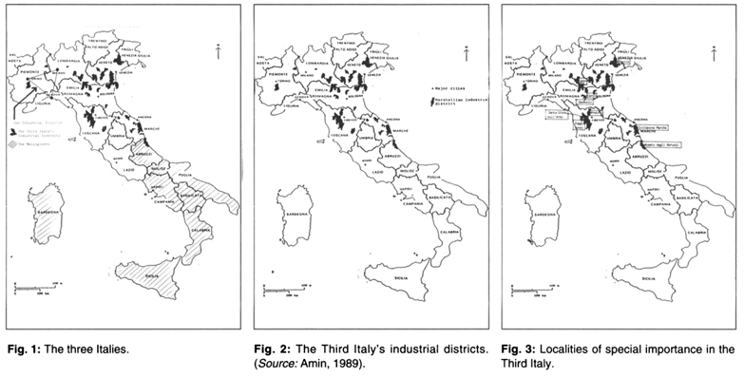
1. Territorially Embedded RIS (Grassroots RIS)
Firms primarily in those industries relying on synthetic knowledge base innovation activity mainly on localized learning processes by geographical, social and cultural proximity without much interaction with knowledge organizations.
e.g., bottom-up networks of SMEs in industrial districts (Third Italy)
Bianchini (1991), The Third Italy: Model or Myth?, Ekistics 58

Slide 32
| Industrial District
Socio-territorial entity characterized by the active presence of both a community of people and a population of firms in one naturally and historically bounded area
Marshallian industrial district: a matter of time
Primitive localization, if it last long, becomes more compound localization
Through the passing of time, it acquires a special atmosphere or milieu with six advantages:
Heredity skills, growth of subsidiary trades, growth of highly specialized machinery, local market for special skill, industrial leadership, introduction of novelties
Becattini 1990, “The Marshallian industrial district as a socio-economic notion,” in Industrial Districts and Inter-firm Co-operation in Italy edited by Becattini & Sengenberger
Belussi & Caldari 2009, “At the origin of the industrial district: Alfred Marshall and the Cambridge School,” Cambridge Journal of Economics

Slide 33
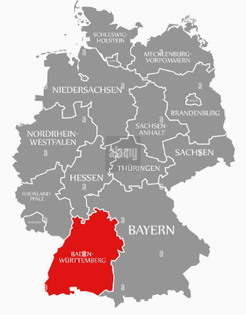
2. Regionally Networked Innovation System (Network RIS)
More planned/intentional strengthening of the region’s institutional infrastructure
e.g., Baden-Wurttemberg (Germany)
Third highest gross regional product (GRP) as a home to Mercedez-Benz, Daimler-Chrysler, Porsche, Bosch
Key local competence being the ability to solve complex technological problems of their consumers in custom-designed solutions or improvements
Backed by strong vocational education, apprenticeship, well-organized Chamber of Commerce, highly specialized/regionally organized producer associations

Slide 34
3. Regionalized NIS (Dirigiste RIS)
Parts of industry and institutional structures more functionally integrated into national or international innovation systems
Collaboration between organizations conforming closely to the linear model
e.g., science parks as planned innovative milieu

Slide 35
RIS-NIS Relations
General correspondence between macro-institutional characteristics of the national economy and the dominant form/character of its RIS
Coordinated market economies (CMEs) on the macro level support cooperative, long-term, and consensus-based relations between private as well as public actors.
Liberal market economies (LMEs) promote competitive adjustment to new requirements and opportunities with short-term financial incentives.

Slide 36

| Varieties of Capitalism (Hall & Soskice 2001)
Two types of market capitalism
istinct political and economic regimes and performance of advanced capitalist economies → liberal market economy (LME) vs. coordinated market economy (CME)
Compared on five spheres
Industrial relations
Vocational training and education
Corporate governance
Inter-firm relations
Employee-management relations

Slide 37
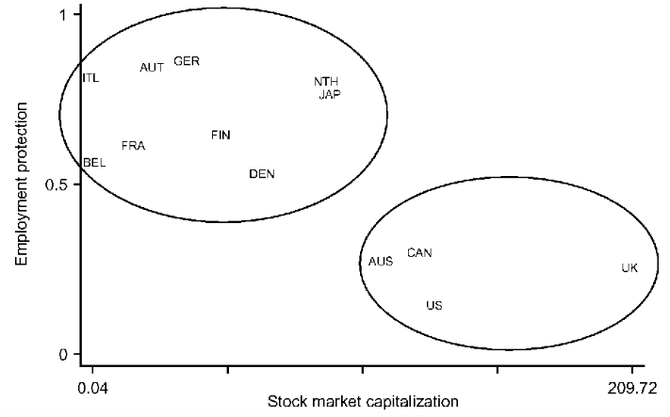
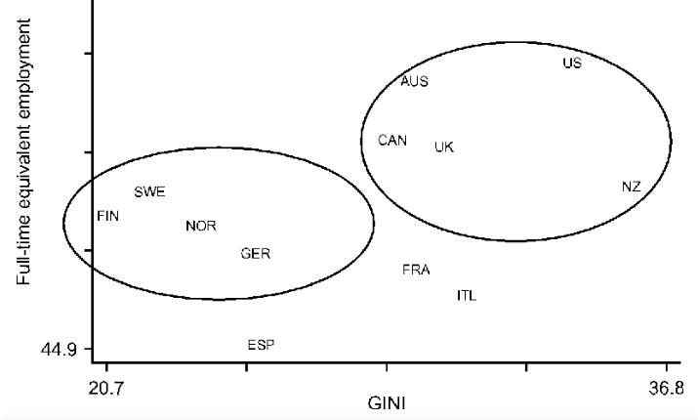
| Varieties of Capitalism

Slide 38
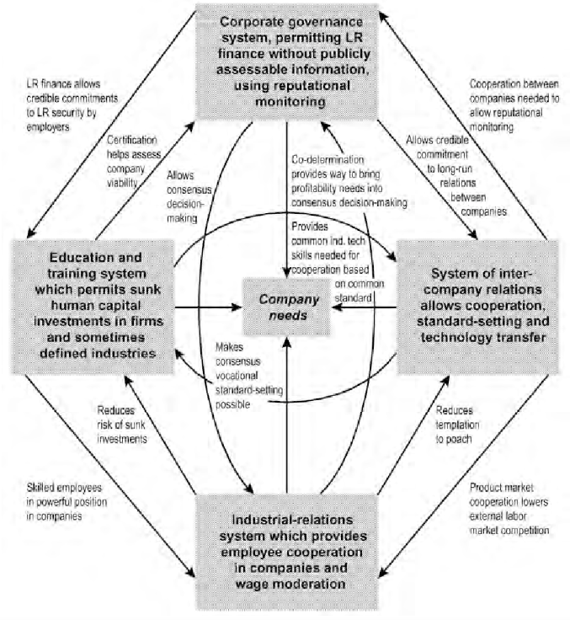
| CME: Germany
“Patient capital”
Training focused on specific skills
Long-term employment
Cooperative standard setting & tech transfer
Managers & employees forming cooperative relations
→ Incremental innovation

Slide 39
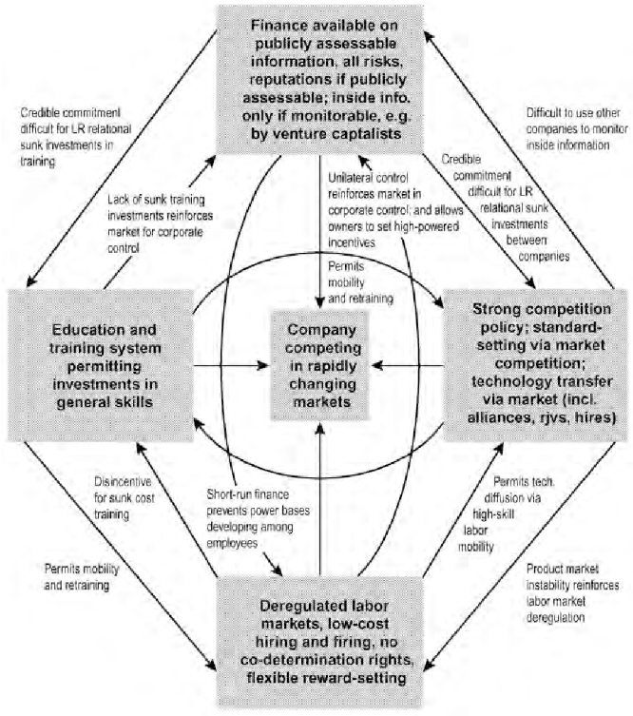
| LME: US
Short-term capital (stock markets)
Training focused on general skills
Strong mobility and retraining
Standard setting via market competition
Managers and employees in adversarial relations
→ Radical innovation

Slide 40
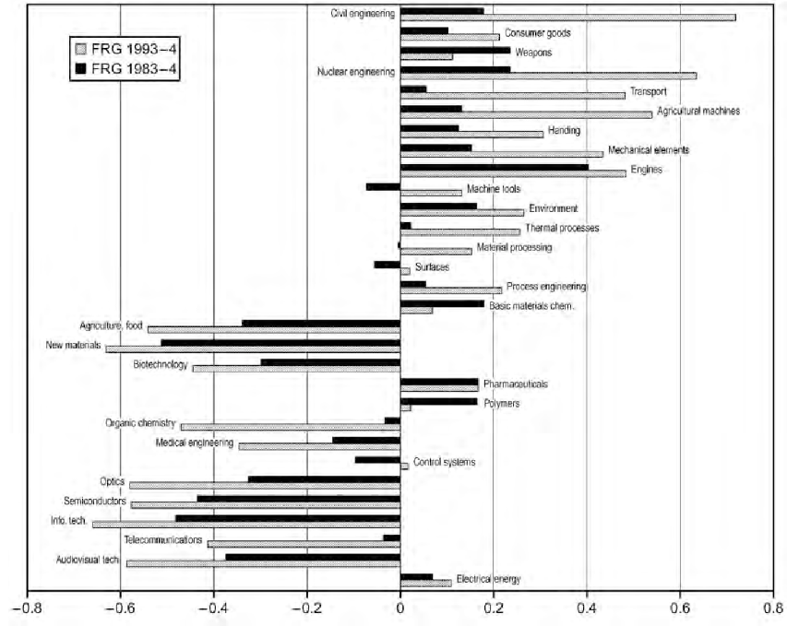
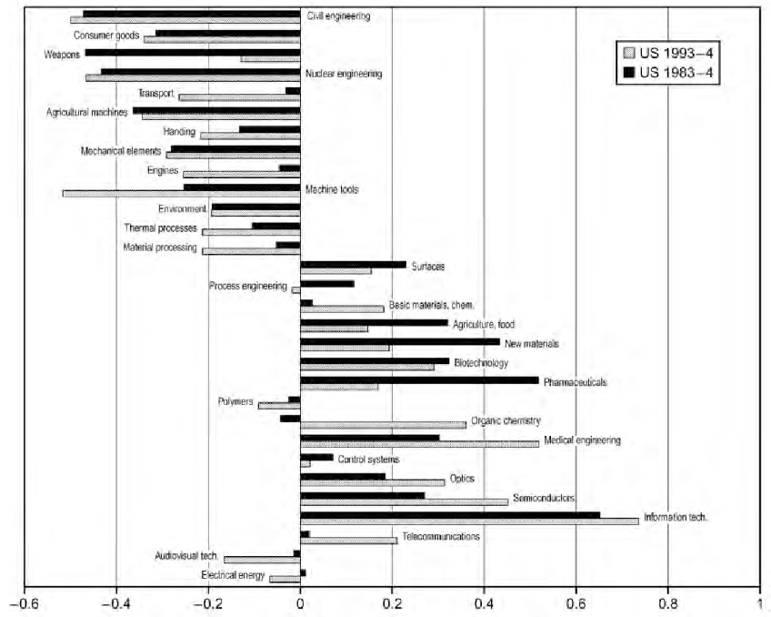
| VoC and Innovation Outcomes
Patent specialization by technology classes (positive figures meaning greater specialization)

Slide 41
Back to RIS-NIS Relations
Traditional
New Economy
IRIS (institutional RIS)
German/North Europe
Synthetic knowledge base
Path-dependent tendency rather than destructive technology/innovation → gradual evolution
NEIS (new economy innovation system)
UK/US
Analytical knowledge base
Fewer system elements
Dynamic in entrepreneurship and markets

Slide 42
| Biotech Clusters (Cortright & Mayer 2002)
Biotech innovations in the US dominated by only a handful of metropolitan centers. Why?
Presence of first-class pre-commercial medical research in a local or government laboratory
Local systems to support and encourage entrepreneurial activity leading to successful translation of research into commercially viable outputs.
Yet, non-local forces also play a key role → e.g., NIH, big pharma, non-local venture capital

